Slide 1
Anti sleep alarm for drivers

Slide 2
Anti sleep alarm for drivers, an IOT based project for keeping awake a person that is about to fall asleep is proposed, comprising a pair of glasses with a frame that has two arms, sensor for detecting the movements of an eye blink.
If a person closes his eyes for two seconds then the buzzer gets activated, and even after two seconds if that person doesn’t open his eyes the vehicle stops automatically.
This technique is useful for avoiding road accidents.

Slide 3
Components required
Relay
Piezo buzzer
Wires
9V battery
Gear motor
Wheel
Arduino nano
Switch
Eye blink sensor

Slide 4
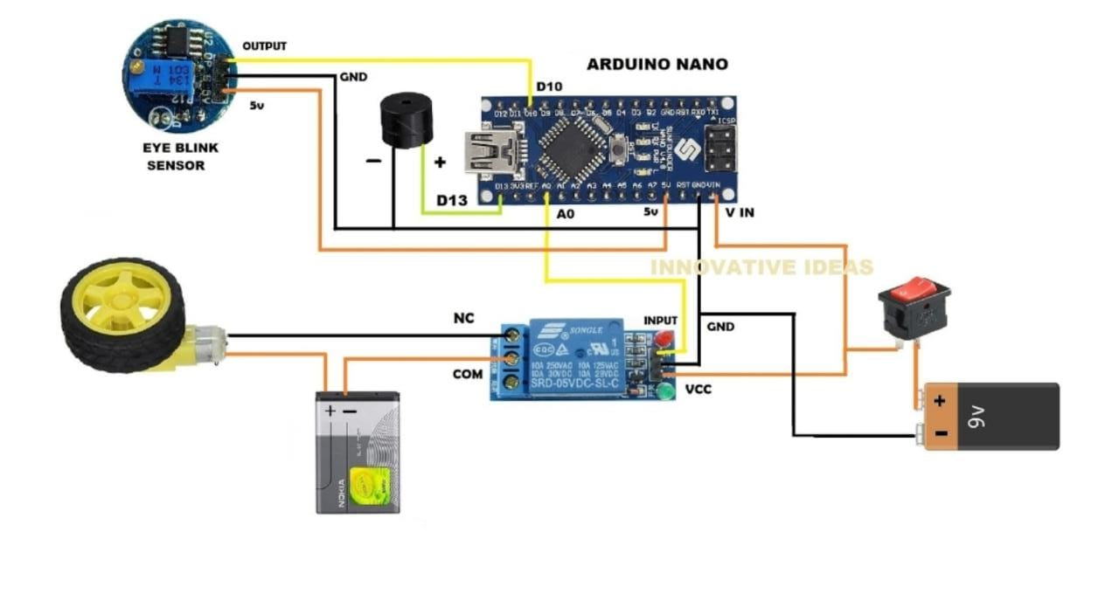
Circuit diagram

Slide 5
Code
#define Relay 13
#define buzzer A0
static const int sensorPin=10;
int SensorStatePrevious=LOW;
unsigned long minSensorDuration2=6000;
unsigned long SensorLongMillis;
bool SensorStateLongTime = false;
const int intervalSensor = 50;
unsigned long previousSensorMillis;
unsigned long SensorOutDuration;
unsigned long currentMillis;
void setup()
{
Serial.begin(9600);
pinMode(sensorPin, INPUT);
Serial.println("Press button");
pinMode(Relay,OUTPUT);
pinMode(buzzer,OUTPUT);
}

Slide 6
void readSensorState()
{
if(currentMillis - previousSensorMillis > intervalSensor)
{
int SensorState = digitalRead(sensorPin);
if (SensorState == LOW && SensorStatePrevious == HIGH && !SensorStateLongTime)
{
SensorLongMillis = currentMillis;
SensorStatePrevious = LOW;
Serial.println("Button pressed");
}
SensorOutDuration = currentMillis - SensorLongMillis;
if (SensorState == LOW && !SensorStateLongTime && SensorOutDuration >= minSensorDuration)
{
SensorStateLongTime = true;
digitalWrite(Relay,HIGH);
Serial.println("Button long pressed");
}

Slide 7
if (SensorState == LOW && SensorStateLongTime && SensorOutDuration >= minSensorDuration2)
{
SensorStateLongTime = true;
digitalWrite(buzzer,HIGH);
delay(1000);
Serial.println("Button long pressed");
}
if (SensorState == HIGH && SensorStatePrevious == LOW)
{
SensorStatePrevious = HIGH;
SensorStateLongTime = false;
digitalWrite(Relay,LOW);
digitalWrite(buzzer,LOW);
Serial.println("Button released");
}
previousSensorMillis = currentMillis;
}
}
void loop()
{
currentMillis = millis();
readSensorState();
}

Slide 9
Thank you

